Slide 1
Broadband ILD fNIRS Study Update
06/07/2024

Slide 2
Behavior (n = 26)

Slide 3



Block averages by channel (PFC)

Slide 4



Block averages by channel (PFC cont)

Slide 5




Block averages by channel (STG Left)

Slide 6




Block averages by channel (STG Right)

Slide 7
Mean HbO topoplots
Speech masker
Noise masker

Slide 8
Block average topoplots (BH corrected)

Slide 9
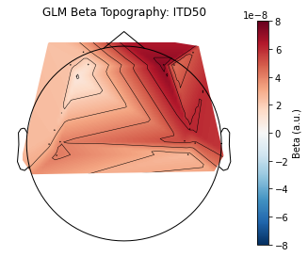
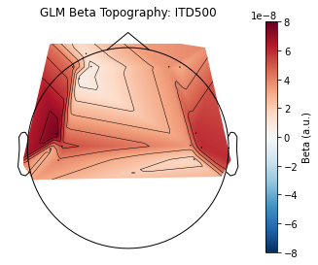
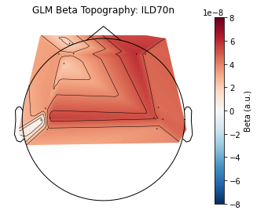
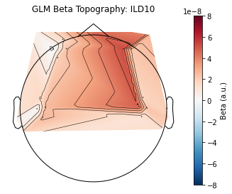
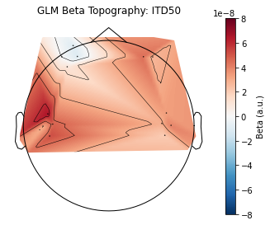
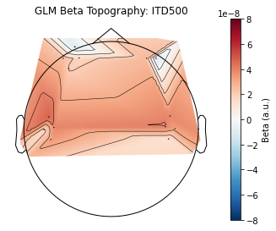
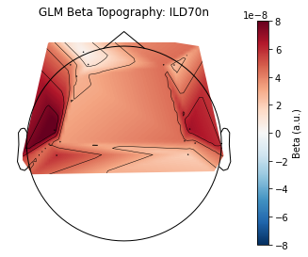
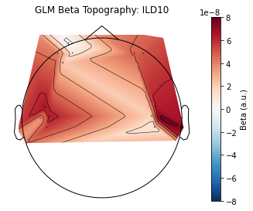
GLM topoplots
Speech masker
Noise masker

Slide 10
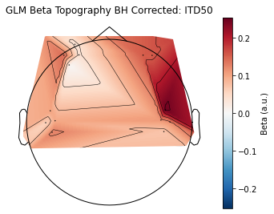
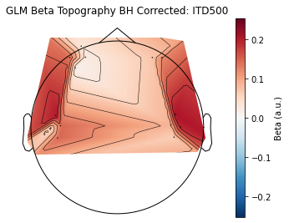
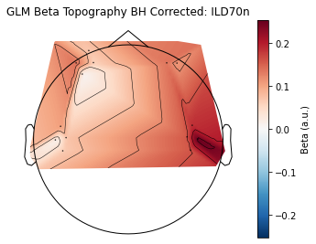
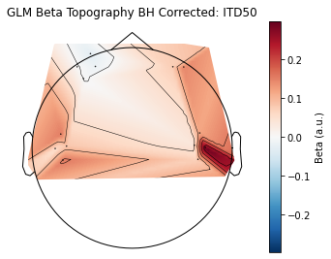
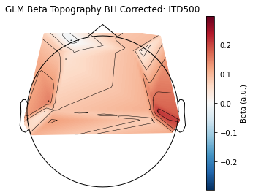
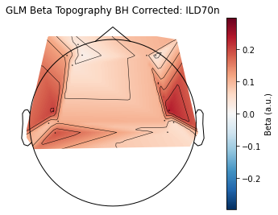
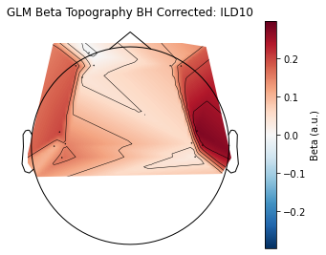
GLM topoplots (BH Corrected a la Eli)
Speech masker
Noise masker

Slide 11
GLM Channel by Channel, across subjects

Slide 12
Mixed Effects Model Analysis (Mean HbO)

Slide 13
Mixed Effects Model Analysis (Beta)

